Slide 1




Computer Sci Electrical Engr 5590 0005 Big Data Programming Analysis on Covid-19 Vaccination
Prakhya Srungarapu
Sai Saranya Vipparla
Vamshi Krishna Routhu
Shiva Kumar Murarishetti

Slide 2
Introduction
Motivation
Objective
Features
Significance
Architecture
Workflow
Data
Tools & Technologies
Implementation Steps

Slide 3
Introduction
Analyze the vaccination data with charts, news, important dates, and many more is always hard which leads to inaccuracy in analysis and investment in particular stock. This project helps to analyze the Covid-19 vaccination data and the data is collected from twitter data, implemented using Hadoop ecosystem. It collects the twitter data associated with the vaccination details and analyze/predict the vaccination movement.

Slide 4
Motivation
We have tried hard to analyze the Covid data from the main source twitter and other public sources, but we failed many times. We always have an extremely hard time analyzing that huge amount of data and coming to a decision based on the analysis. And analyzing that huge data takes a lot of time and got to concentrate on various works too. So, to do this task for us we need some sort of Big data tools to analyze and give us filtered results. Not only that as big data tools analyze data extremely fast, we can make decisions quicker than we do. We can also avoid human error using these tools. Moreover, as large number of people are in need of vaccination, we need to have proper data insight so that vaccines can be distributed in an effective and fastest way.

Slide 5
Objective
To analyze covid-19 vaccine data, we will be collecting the twitter data using python script and processing the data. Different tools in Hadoop ecosystem will be used to analyze the data and help in predicting the movement of the Vaccination.

Slide 6
Significance
As many countries are unable to produce the vaccine for their population, their government should have the track of the people getting vaccinated, people showing the interest towards vaccination.
How does their country economy get impacted due to vaccination?
How the distribution should be done?
Big data tools help to process huge amounts of data efficiently.
This would be helpful for the governments and the common people to make their decision towards the vaccination.

Slide 7
Features
The main feature of this project is twitter data extraction, analysis on the extracted data. Using HDFS to store the data. Apache spark to process the data and Hive for querying the data. A visualization tool for showing out the results.

Slide 8
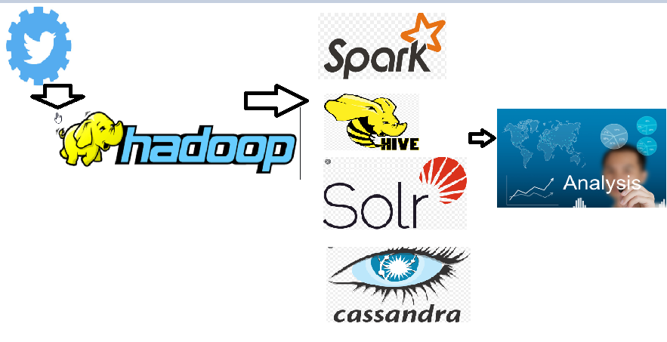
Architecture

Slide 9
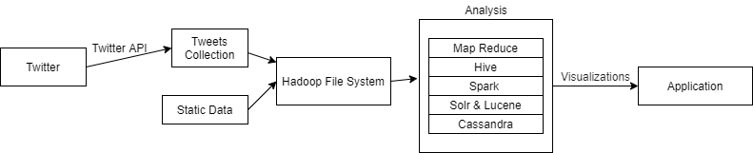
Workflow

Slide 10
Data
Twitter streaming Data - Using Twitter developer API.
Create twitter developer account, generate API key, and token which can be used to download tweets using Tweepy
Public data set used: https://data.chhs.ca.gov/dataset/e283ee5a-cf18-4f20-a92c-ee94a2866ccd/resource/130d7ba2-b6eb-438d-a412-741bde207e1c/download/covid19vaccinesbycounty.csv

Slide 11


STORY TELLING: The Society

Slide 12

Who ?
Who will be impacted? Who were sampled?
Who were over sampled or under sampled?
Who were the data scientists (yourself and your collaborators)?
The People will get impacted using system. We have used the peoples live data on covid vaccines and these were sampled.

Slide 13
What ?
What are the social and cultural impacts? What are the concerns about data privacy, security, and fairness?
The people only get impacted as stated above. We are using the data which is available in public only. We are not dealing with any impacting privacy or security or fairness of data.

Slide 14
When ?
When will the social and cultural impacts take place? When should people be concerned about data privacy, security, and fairness?
There will be no cultural or social impact on the population since the dataset doesn’t populate any personal or confidential information of the person. The fairness of the data needs to be evaluated from time to time.

Slide 15
Where ?
Where will the social and cultural impacts take place? Where will data privacy, security, and fairness issues, like data breach, and evaluative bias, likely to happen?
The group of scientists have collected the data from a social media platform named Twitter. This data is available globally and people all over the globe have access to this data, so the data have no issues or concerns related to privacy or security. The data we have collected using an API developed by Twitter itself, which guarantees the complete authenticity of the data.

Slide 16
Why?
Why are the social and cultural impacts important or consequential to the people and/or the community? Why should we be concerned about data privacy, security, and fairness issues?
In the development of project model and its execution the data used is completely generic and available globally, so there aren’t any issues pertaining to data privacy or security of information, also the data doesn’t contain any medical id or personal information revealing the identity of the person.

Slide 17
Tools & Technologies
Python
Apache Hadoop
Hive
Apache Spark – PySpark, Scala
Apache Solr
Flask

Slide 18
Division of Workflow
Architecture Design
Downloading data from twitter using Tweepy API
Extracting Hashtags from downloaded twitter data
Spark Word Count using Map Reduce
Spark Queries Implementation using PySpark
Queries Implementation using Hive Query Language
Apache Solr Queries Implementation
Flask Web application to query and generate visualizations and send to UI on the fly

Slide 19
Division of Workflow
Analysis of data using Hive
Queries written in Hive
Visualization using Matplotlib, seaborn Packages.
Loading Data into HDFS
Hadoop Word Count using Map Reduce
Instance creation, Schema creation, loading data in Solr, Queries in solr

Slide 20
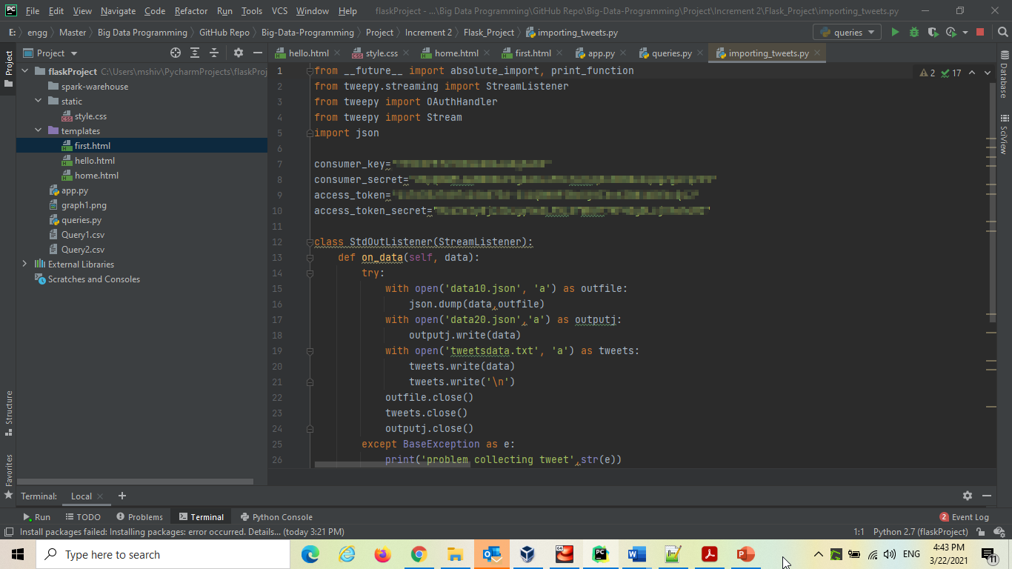
Code Snippet
Twitter Data Download

Slide 21
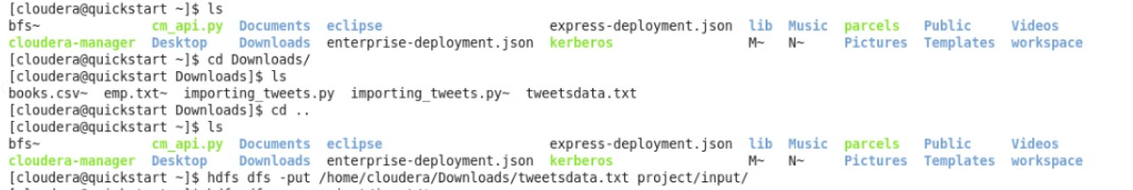
Creating input folder in Hadoop
Moving files to HDFS

Slide 22
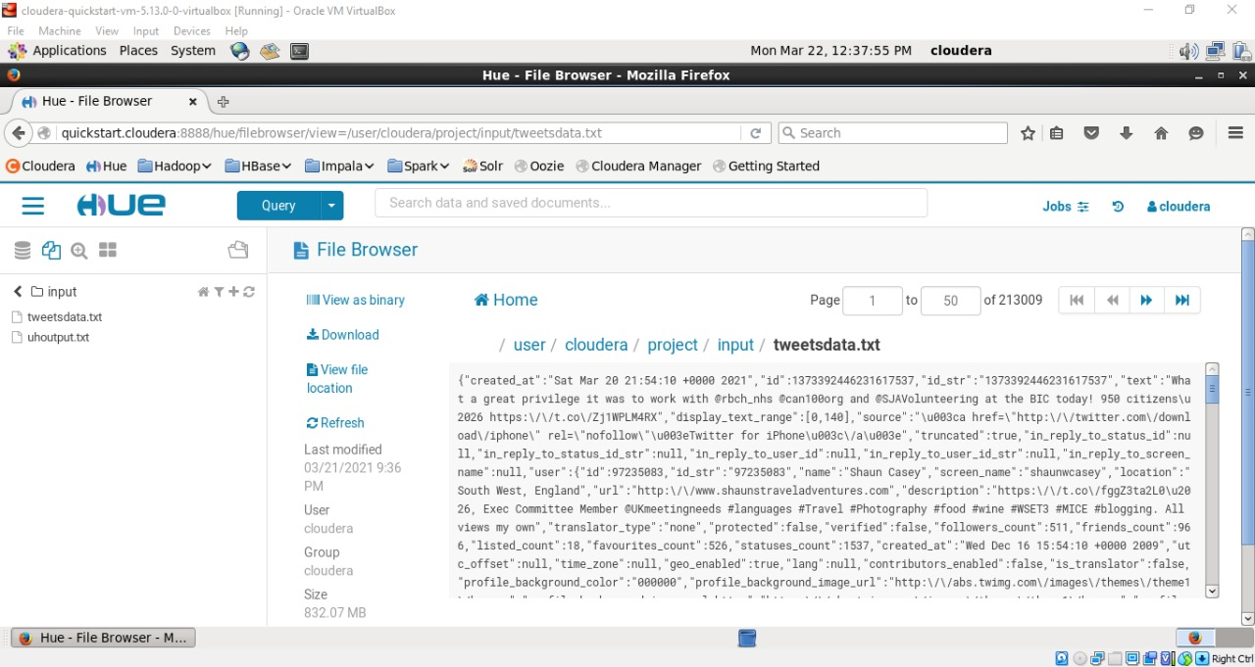
Input Twitter data in HUE

Slide 23
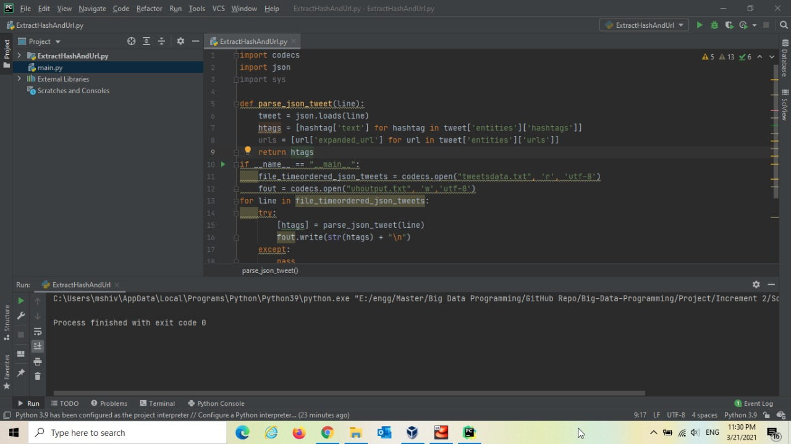
Code Snippet
Hash Tags Extraction

Slide 24
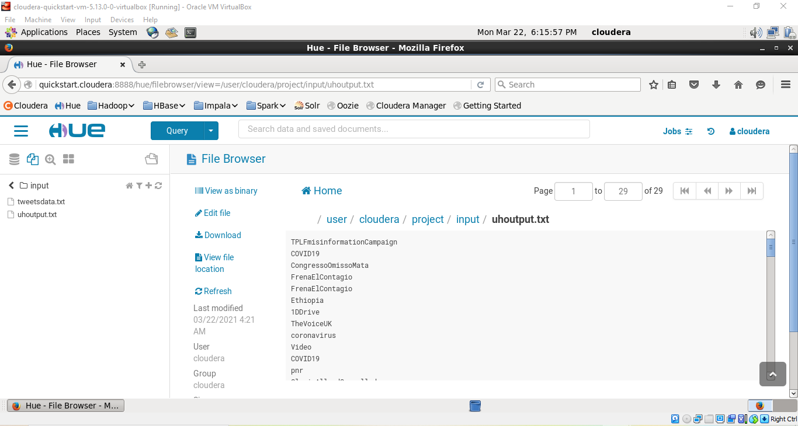

Slide 25
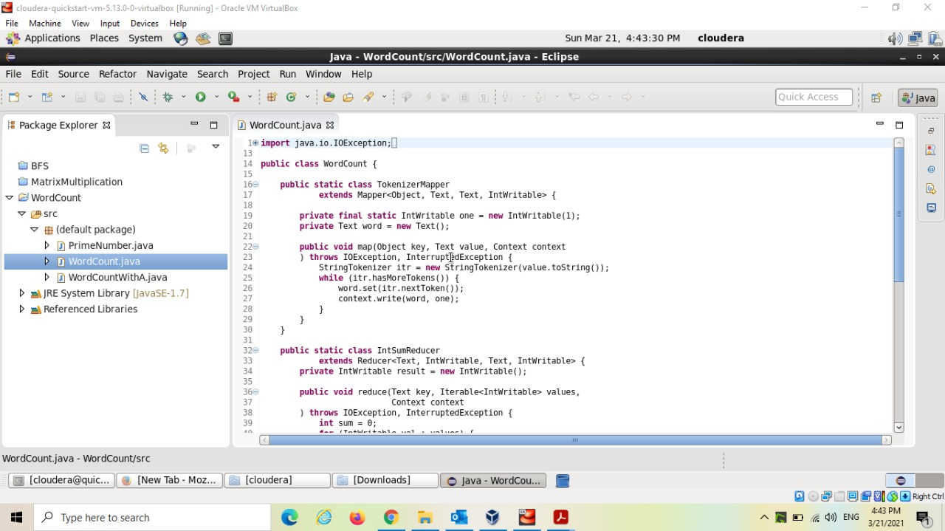
Map Reduce in Java

Slide 26
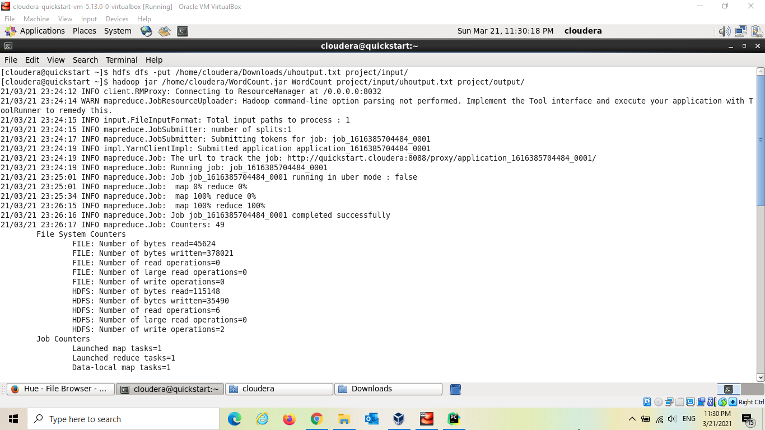

Slide 27
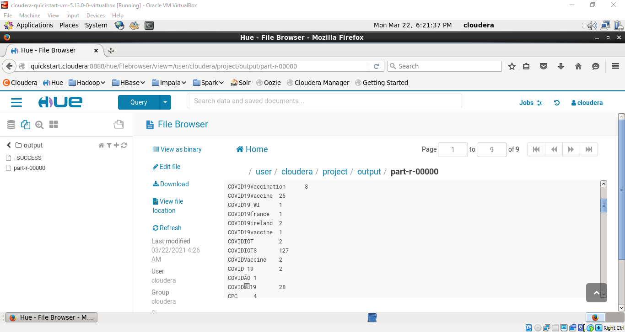

Slide 28
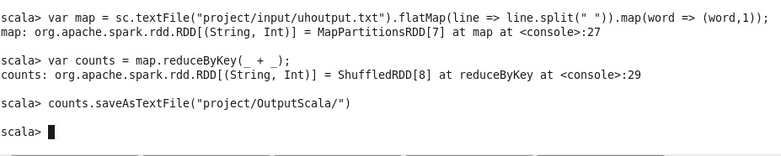
Scala Map Reduce Word Count

Slide 29


Slide 30
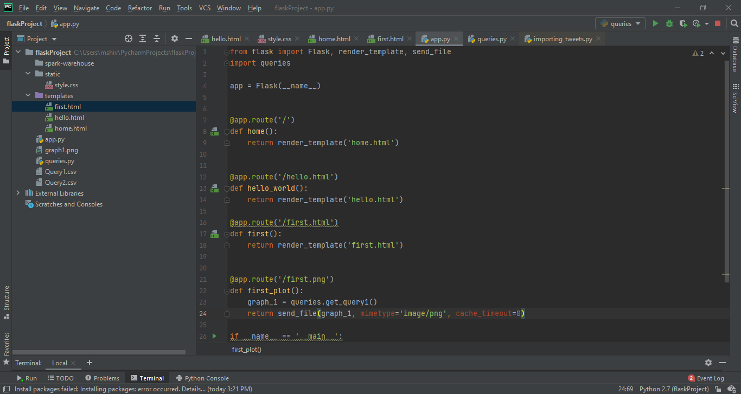

Slide 31
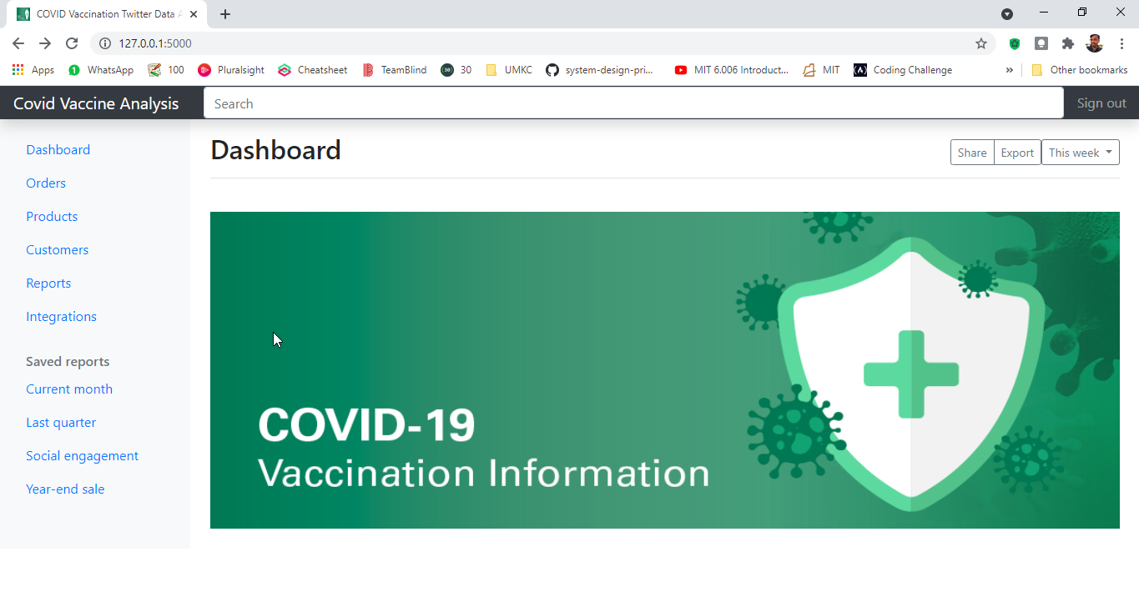

Slide 32
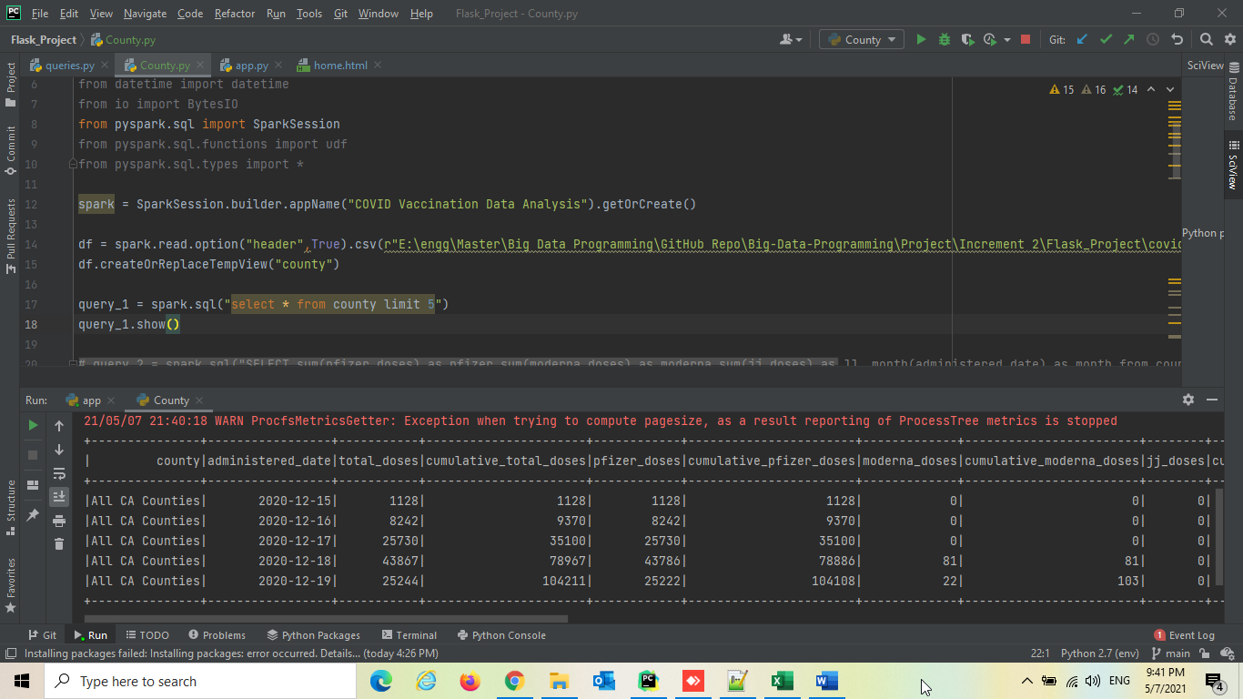
Selecting 5 counties from the dataframe

Slide 33
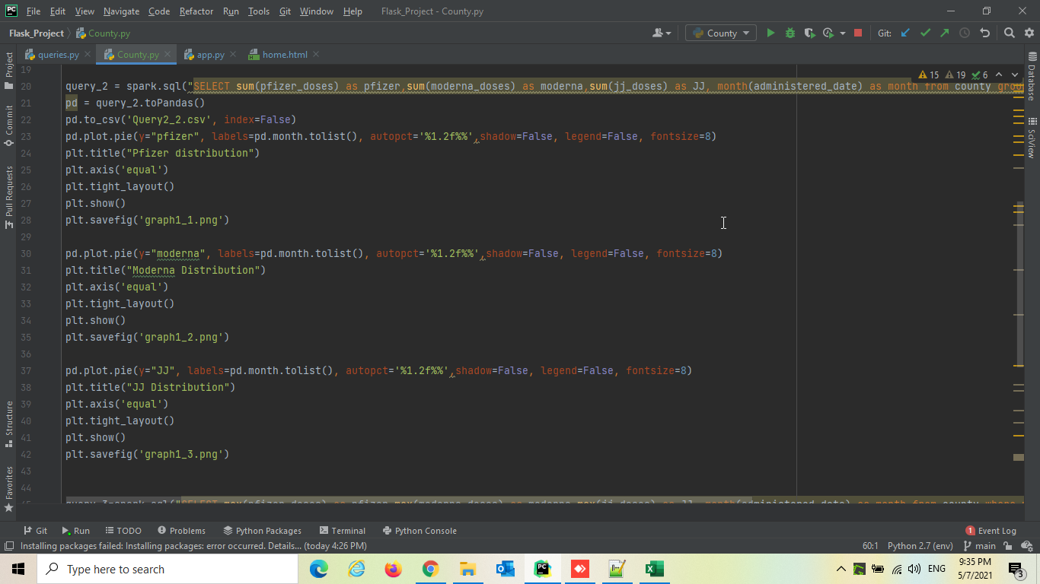
Sum of overall Pfizer, moderna, J&J distribution calculated monthly

Slide 34
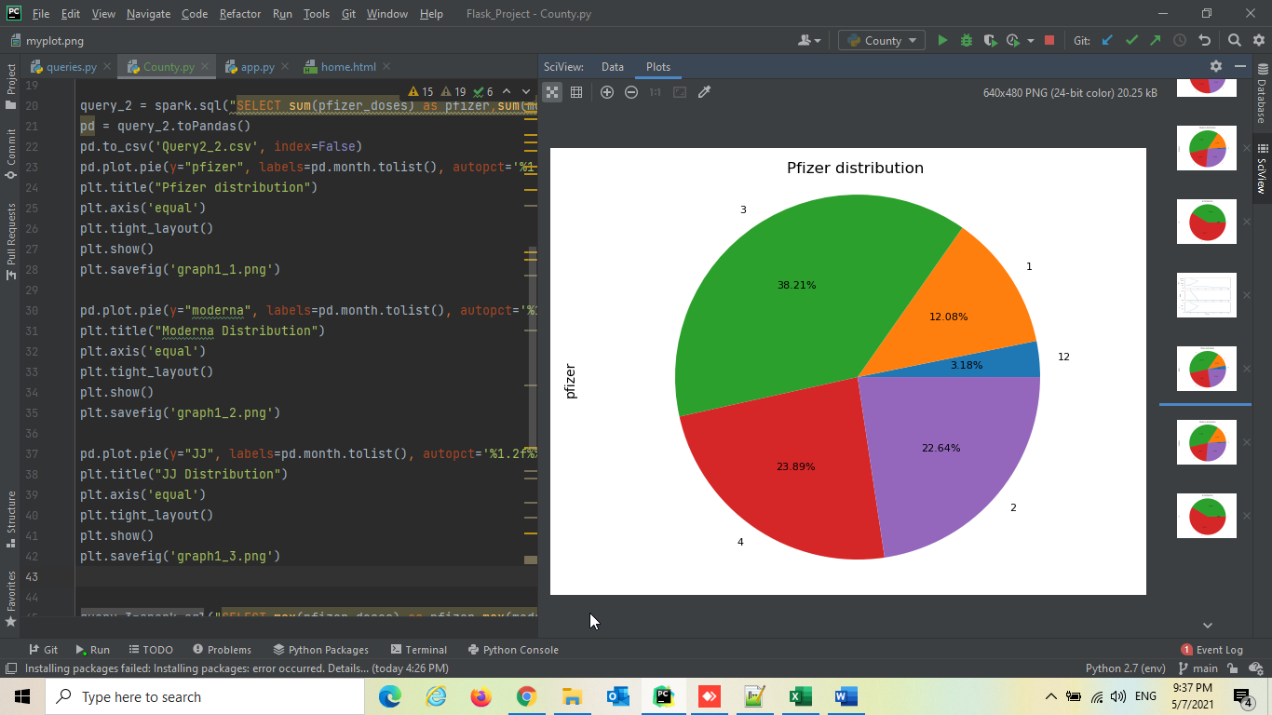
Sum of overall Pfizer distribution calculated monthly

Slide 35
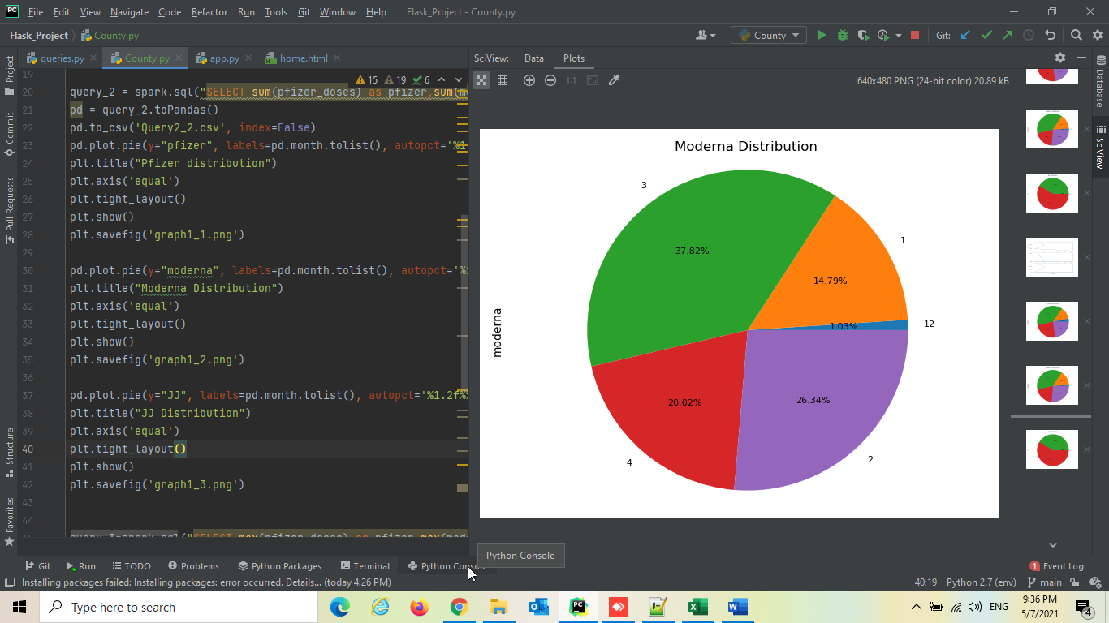
Sum of overall moderna distribution calculated monthly

Slide 36
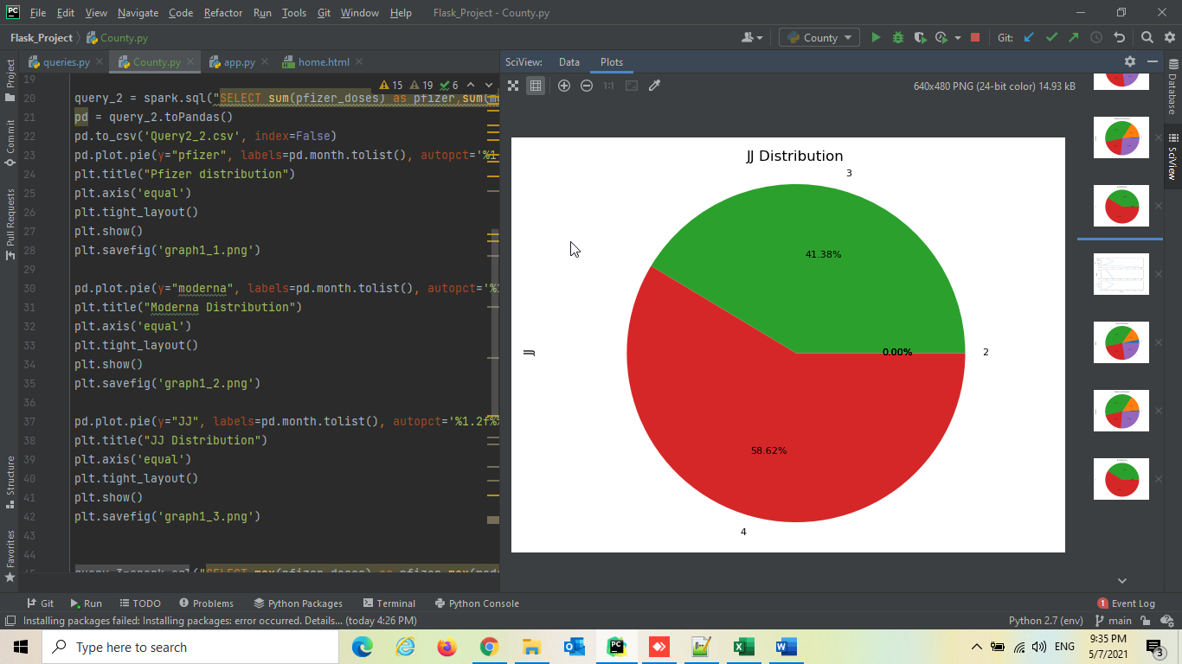
Sum of overall J&J distribution calculated monthly

Slide 37
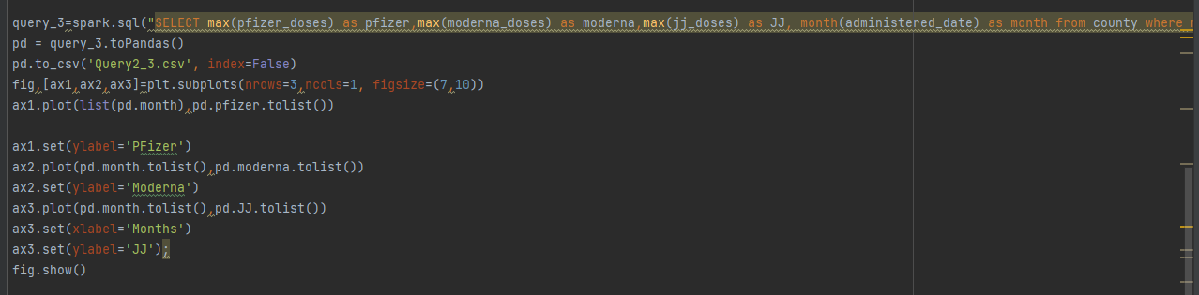
Maximum monthly doses distributed of Pfizer, Moderna, J&J

Slide 38
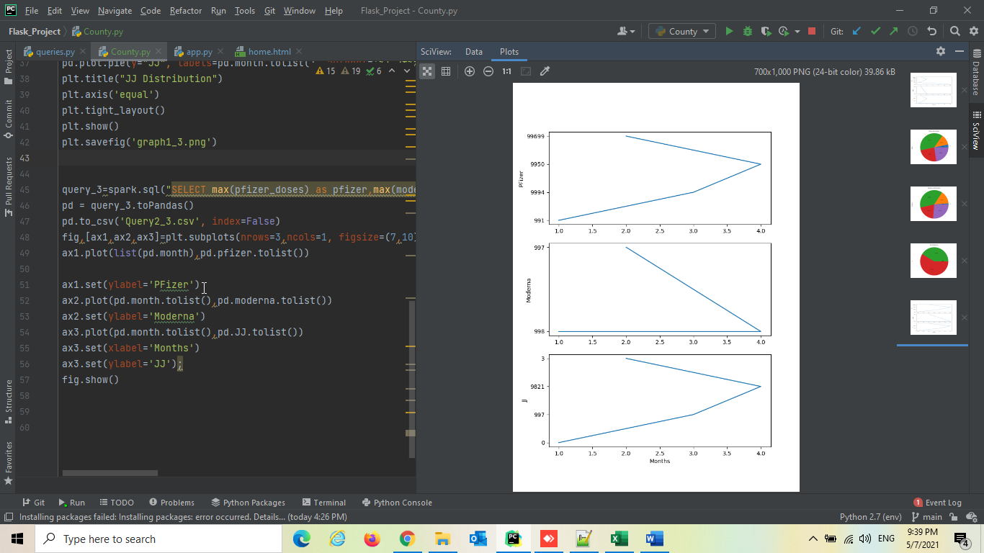

Slide 39
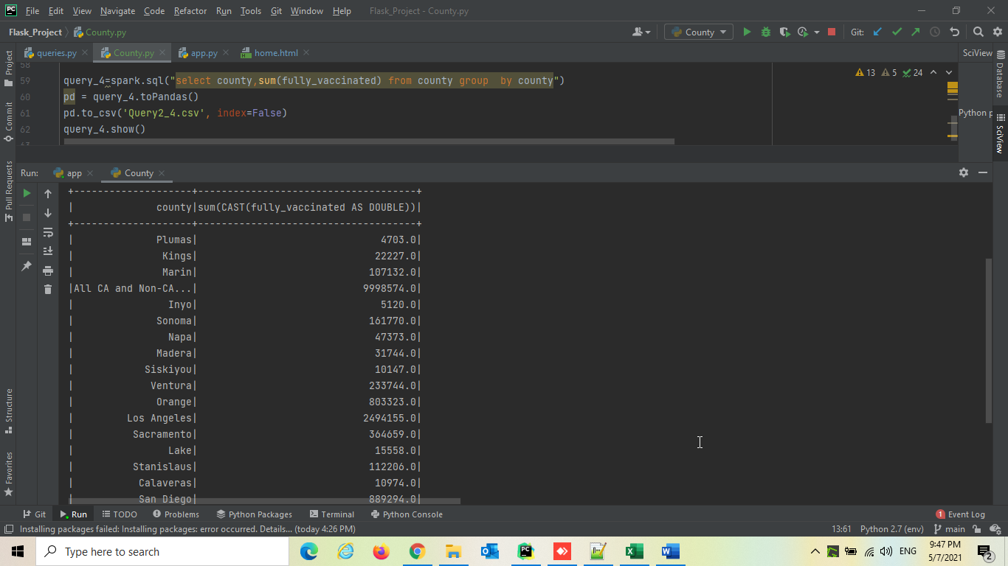
Number of fully vaccinated people based on each County

Slide 40
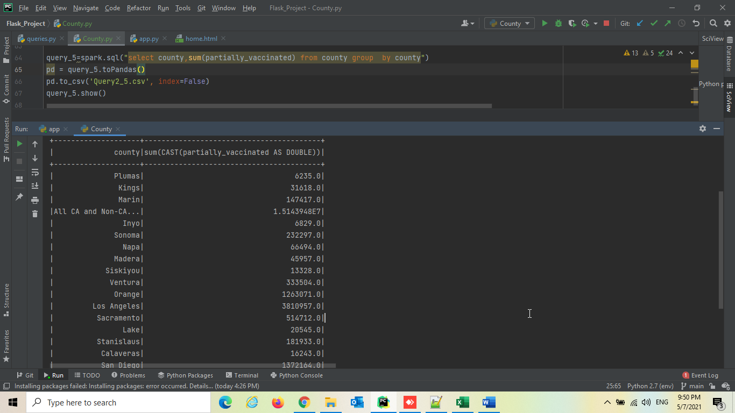
Number of partially vaccinated people based on County

Slide 41
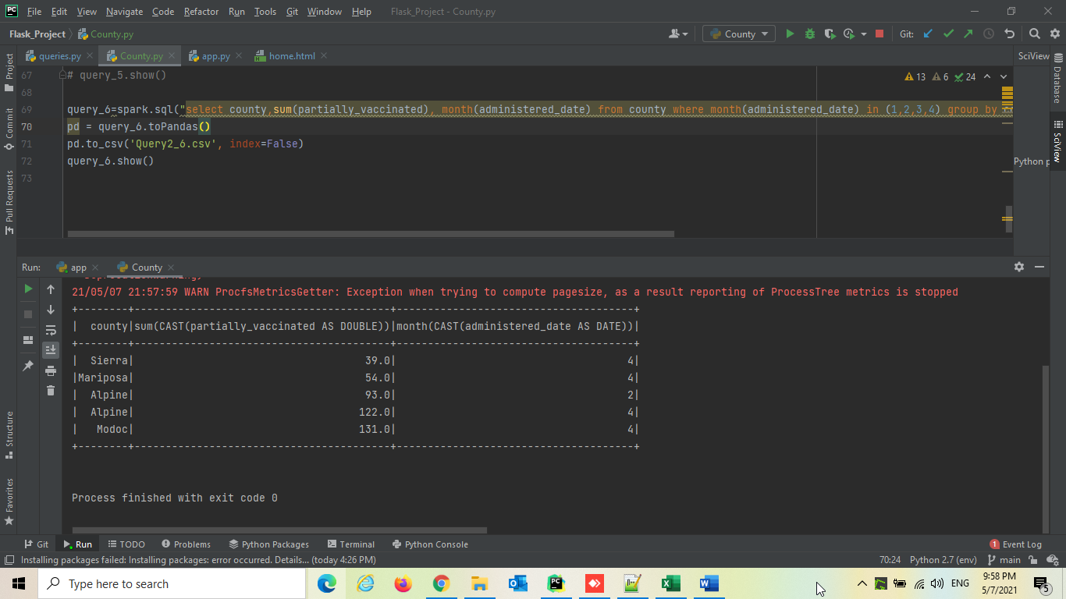
Top 5 Partially vaccinated and fully vaccinated people based on County and month

Slide 42
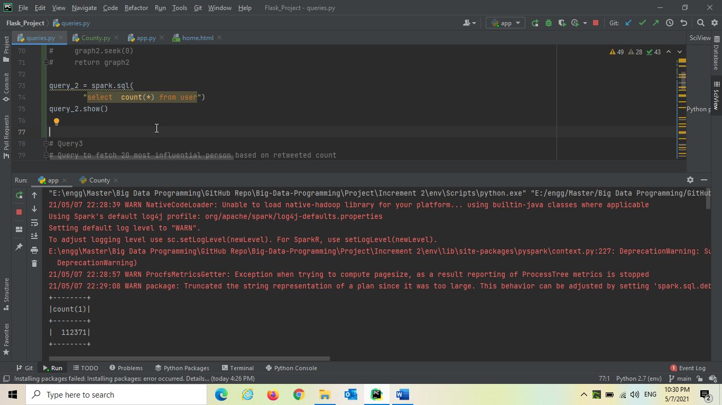
Total Number of tweets processed in Spark

Slide 43
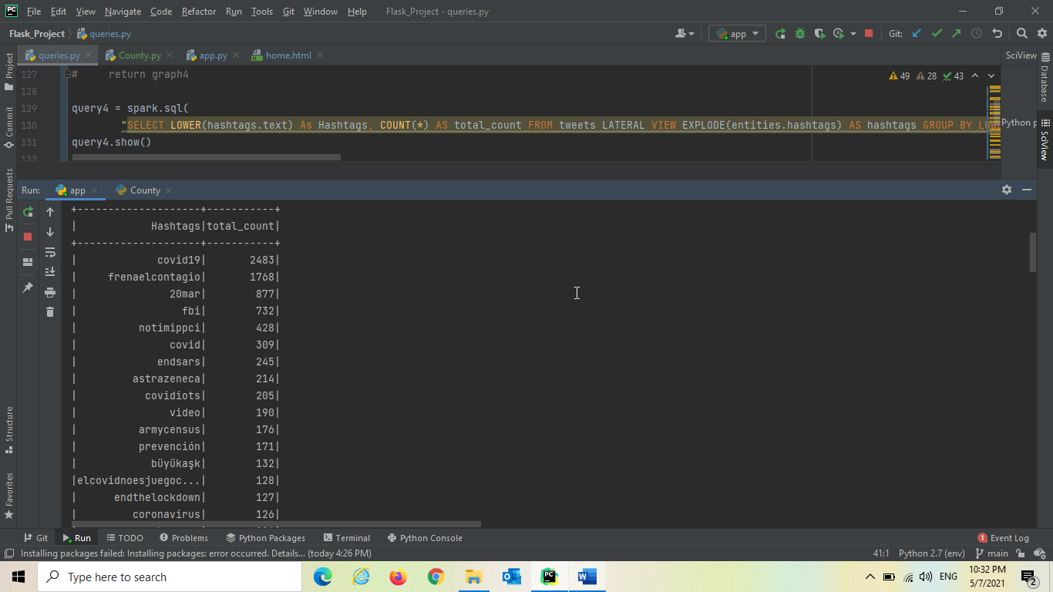
Trending Hashtags

Slide 44
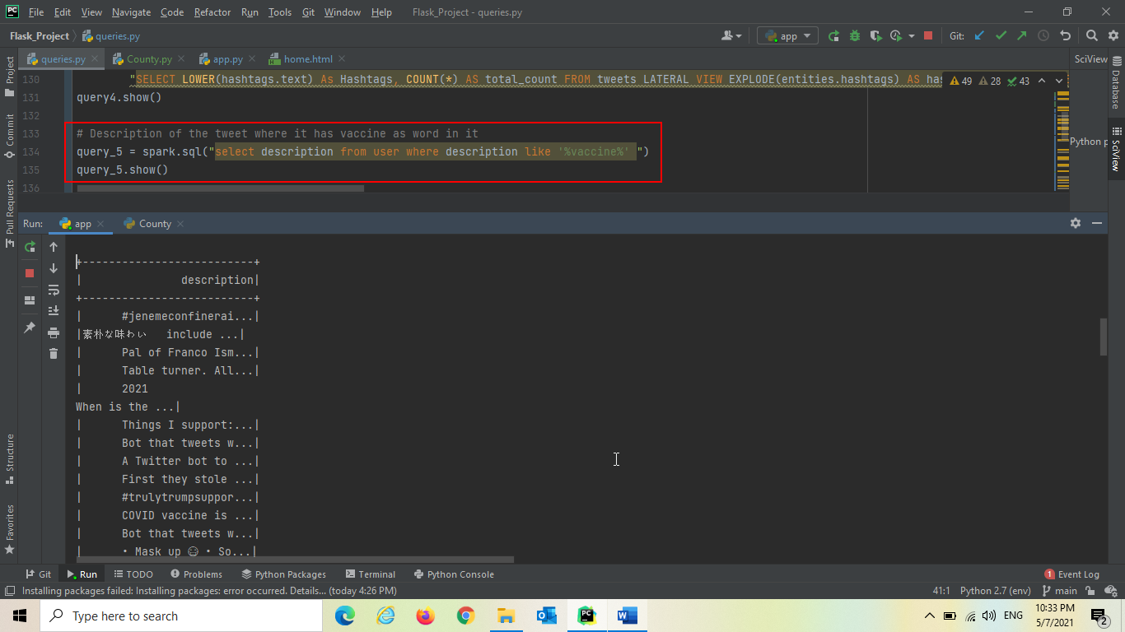
Description from user where it has keyword vaccine

Slide 45
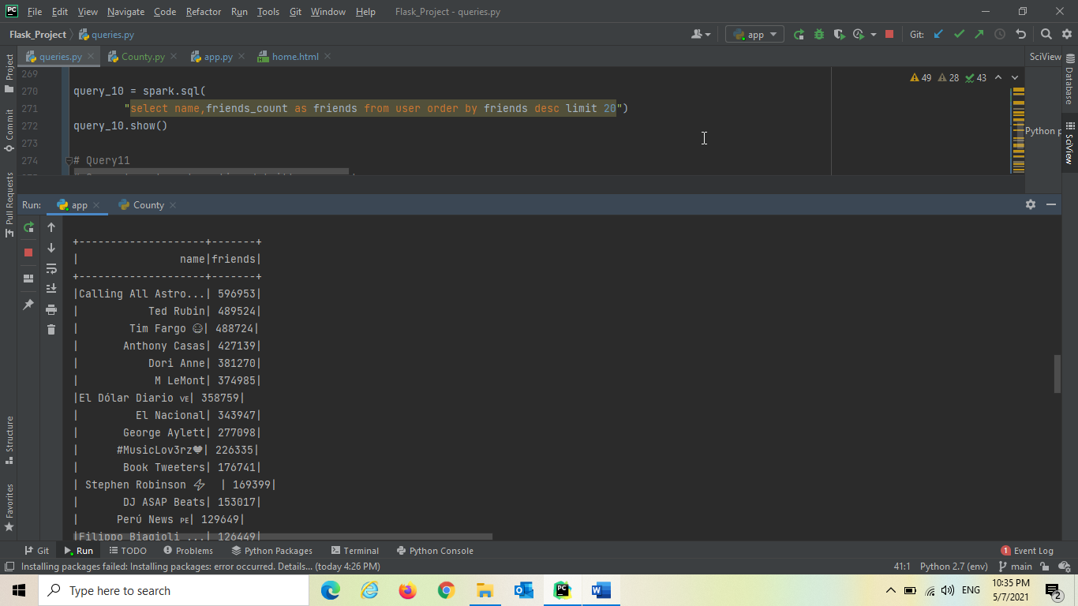
Trends on Number of friends

Slide 46
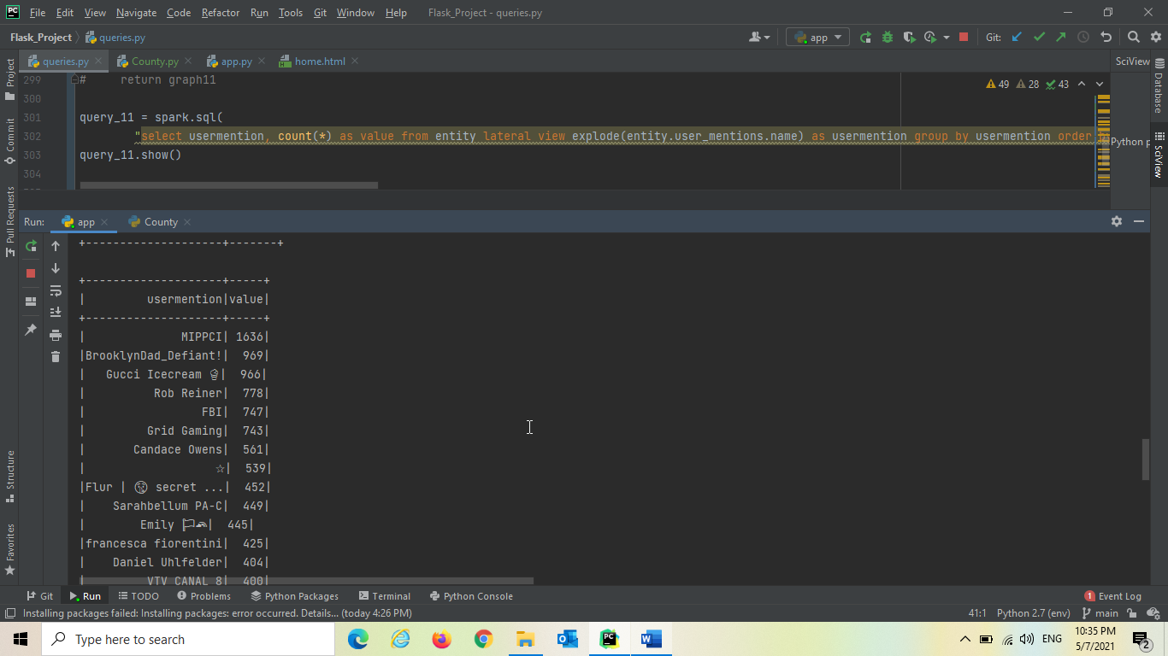
Most Mentioned Twitter Accounts

Slide 47
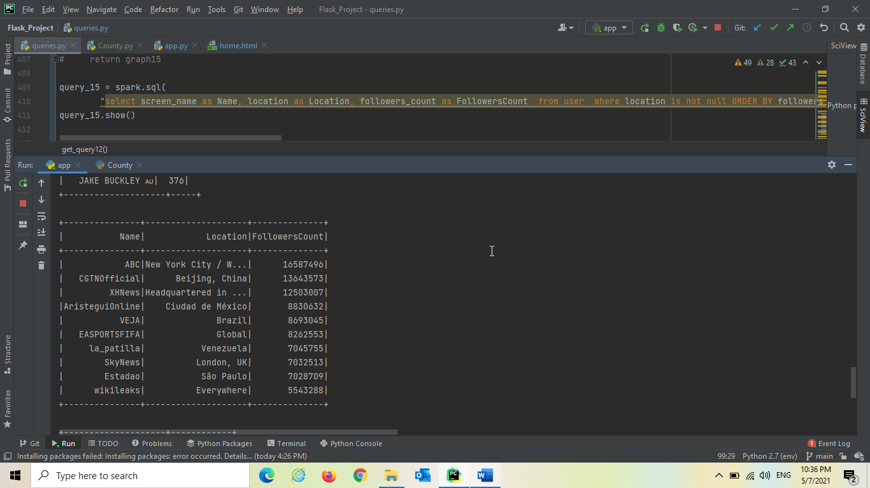
Accounts With More Followers Count Based on Location

Slide 48
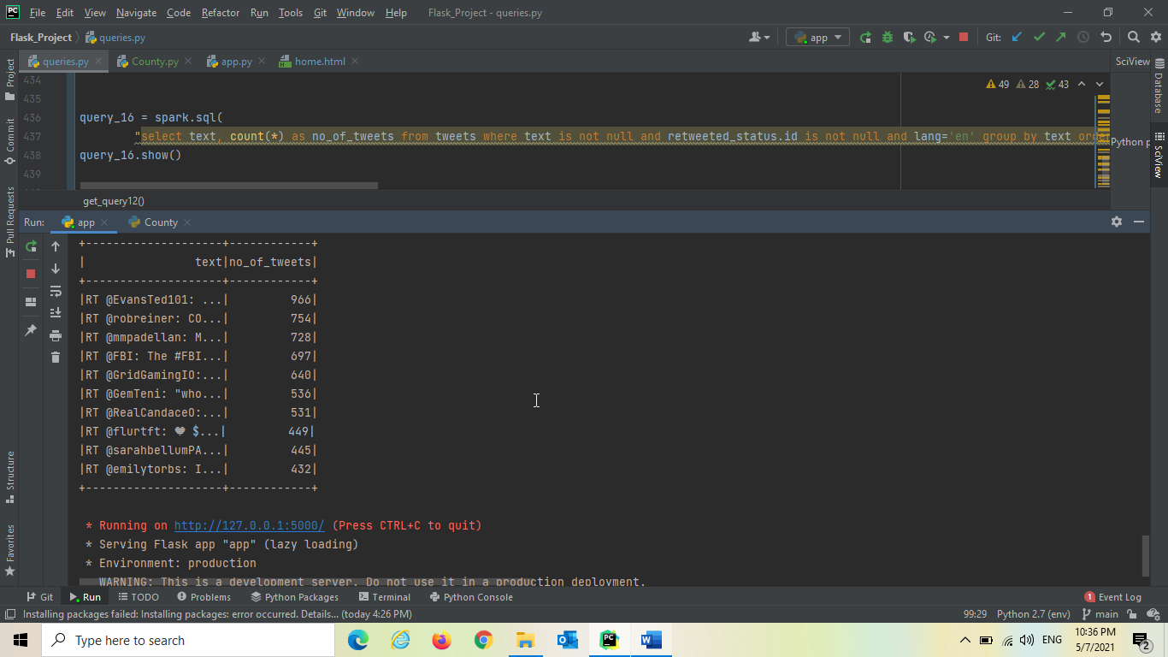
Top Retweeted Tweets (Tweet in english language)

Slide 49
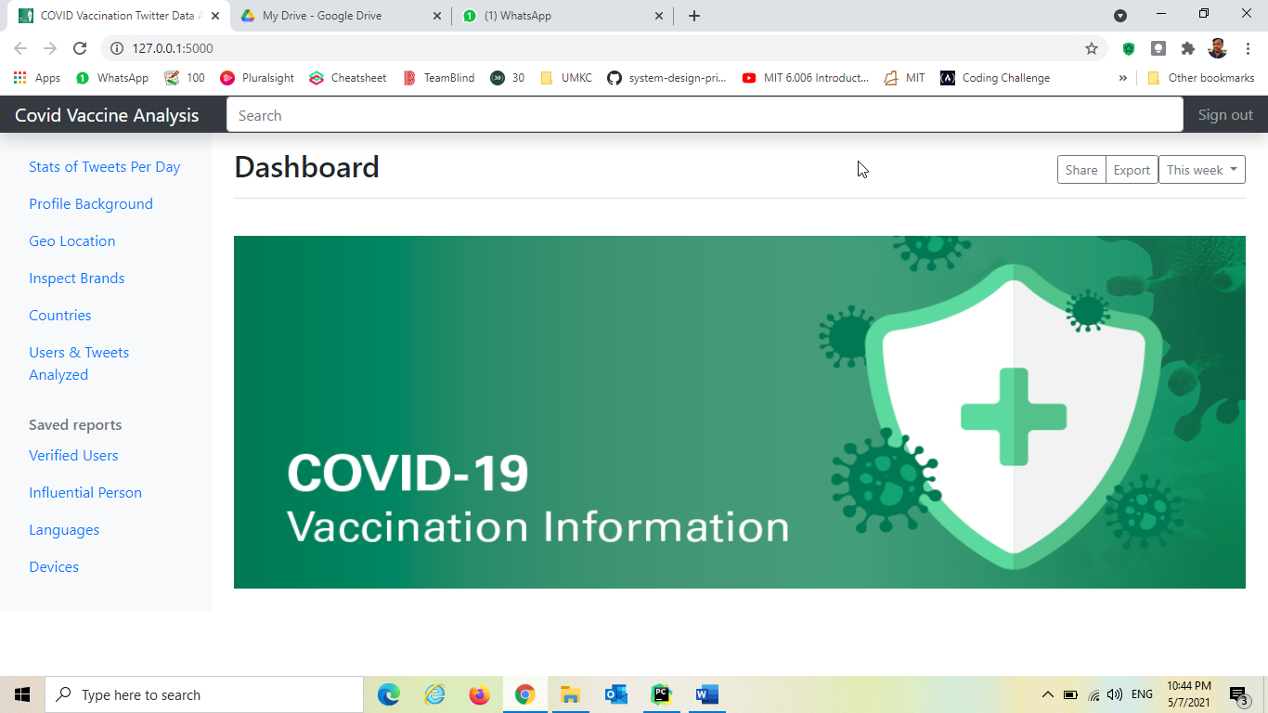
Home page of our Flask web application

Slide 50

When user clicks on Verified Users, it goes and triggers the query “Followers Count of verified Users” and dynamically generates visualization and returned to the application.

Slide 51
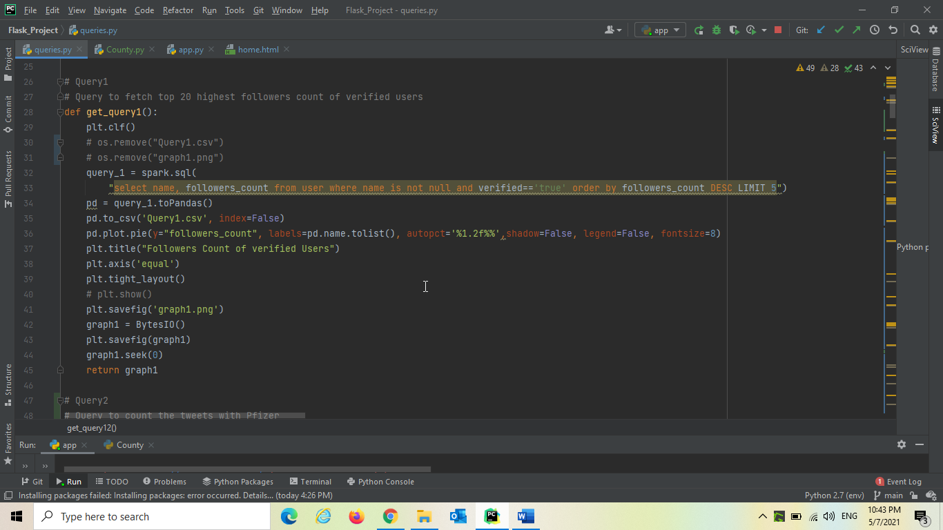
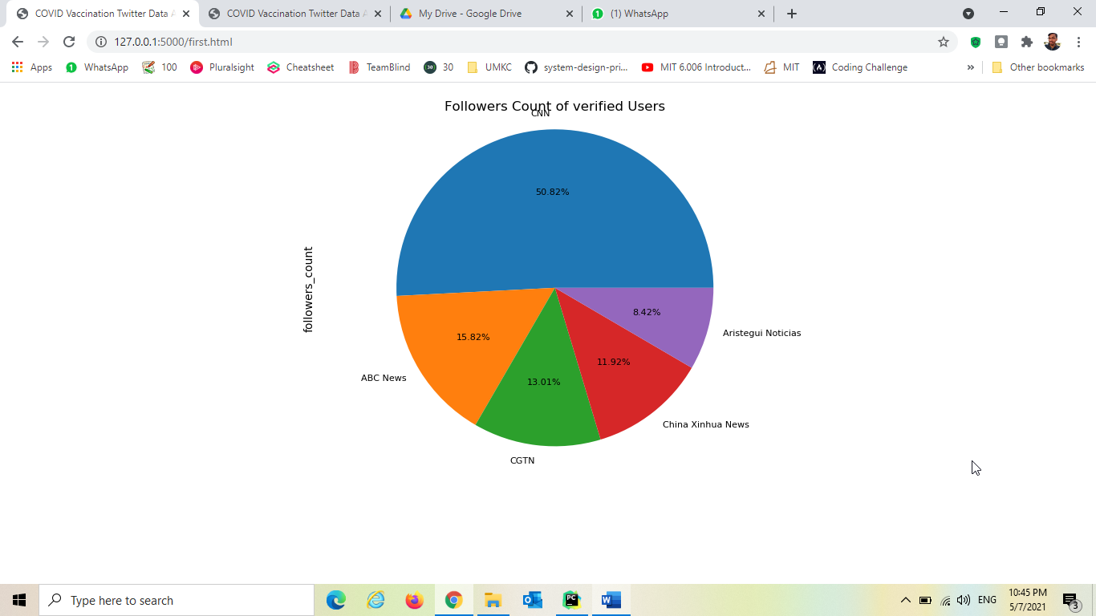

Slide 52

When user clicks on influential person, it goes and triggers the query “Most Influential Person Based on Retweet” and dynamically generates visualization and returned to the application.

Slide 53
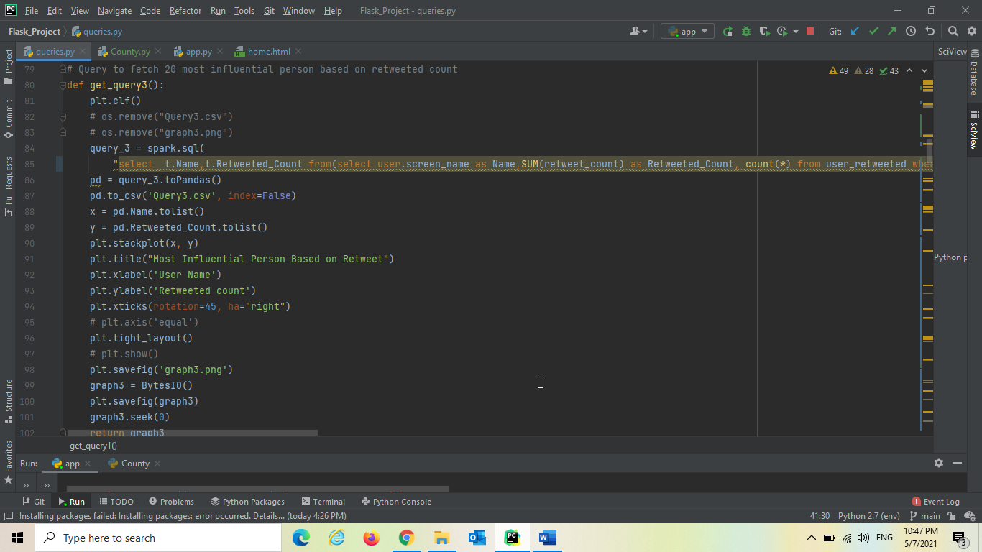
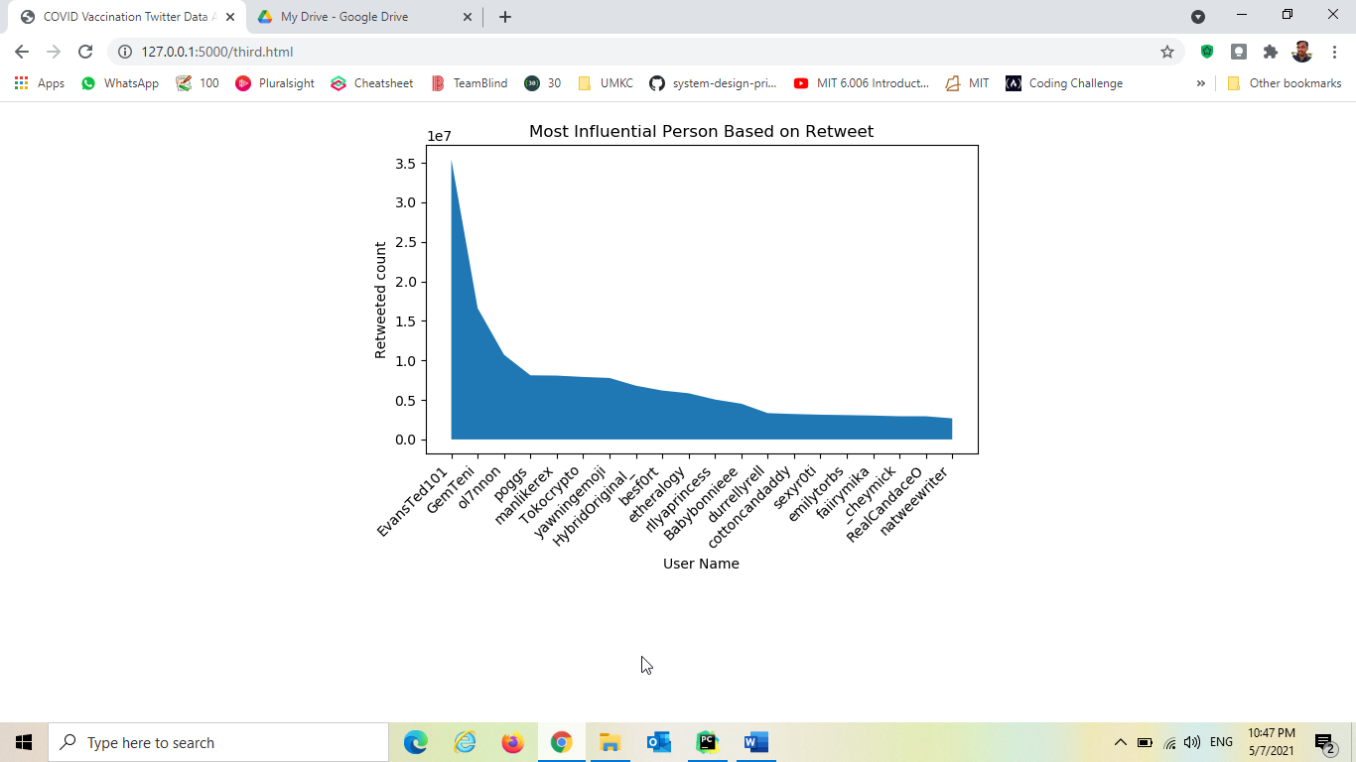

Slide 54

When user clicks on languages, it goes and triggers the query “Top Languages Used in Profile” and dynamically generates visualization and returned to the application.

Slide 55
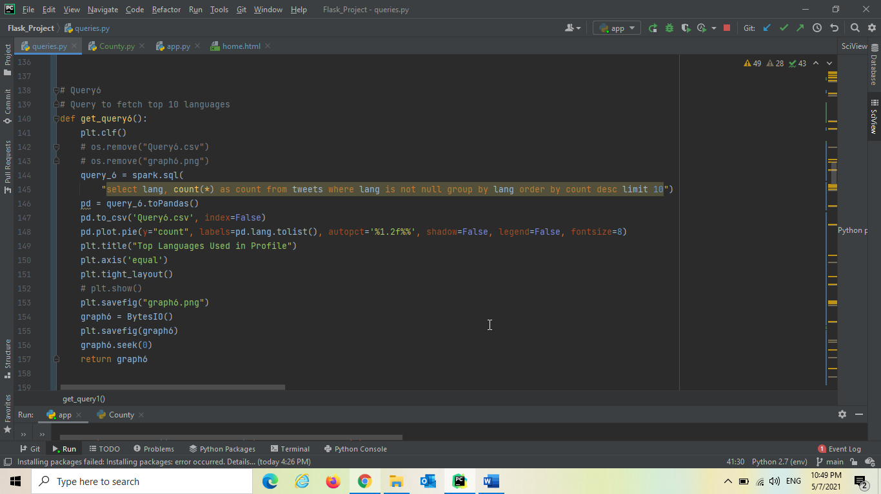
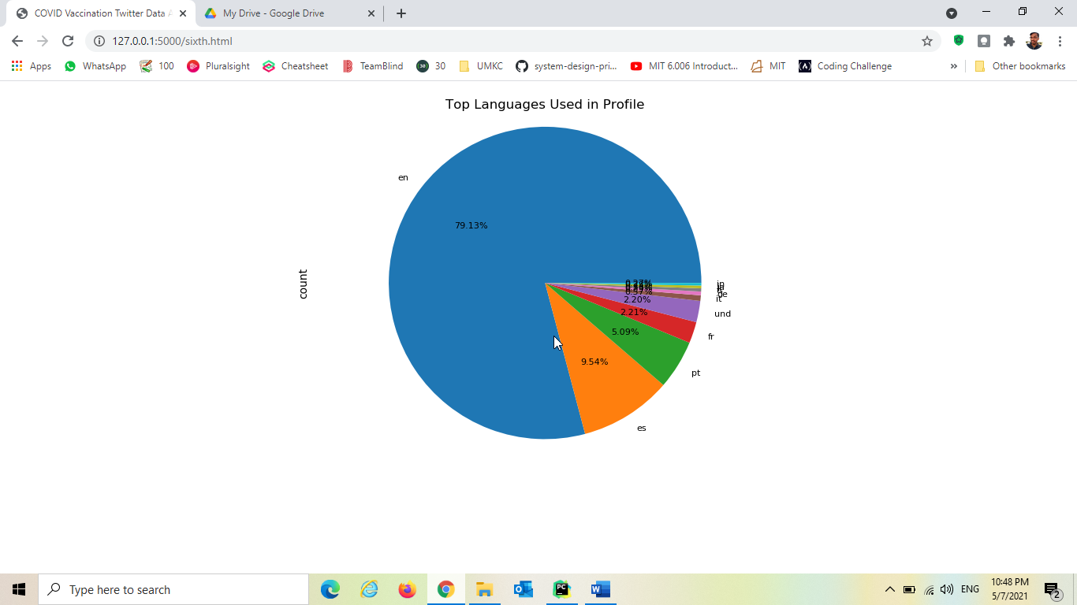

Slide 56
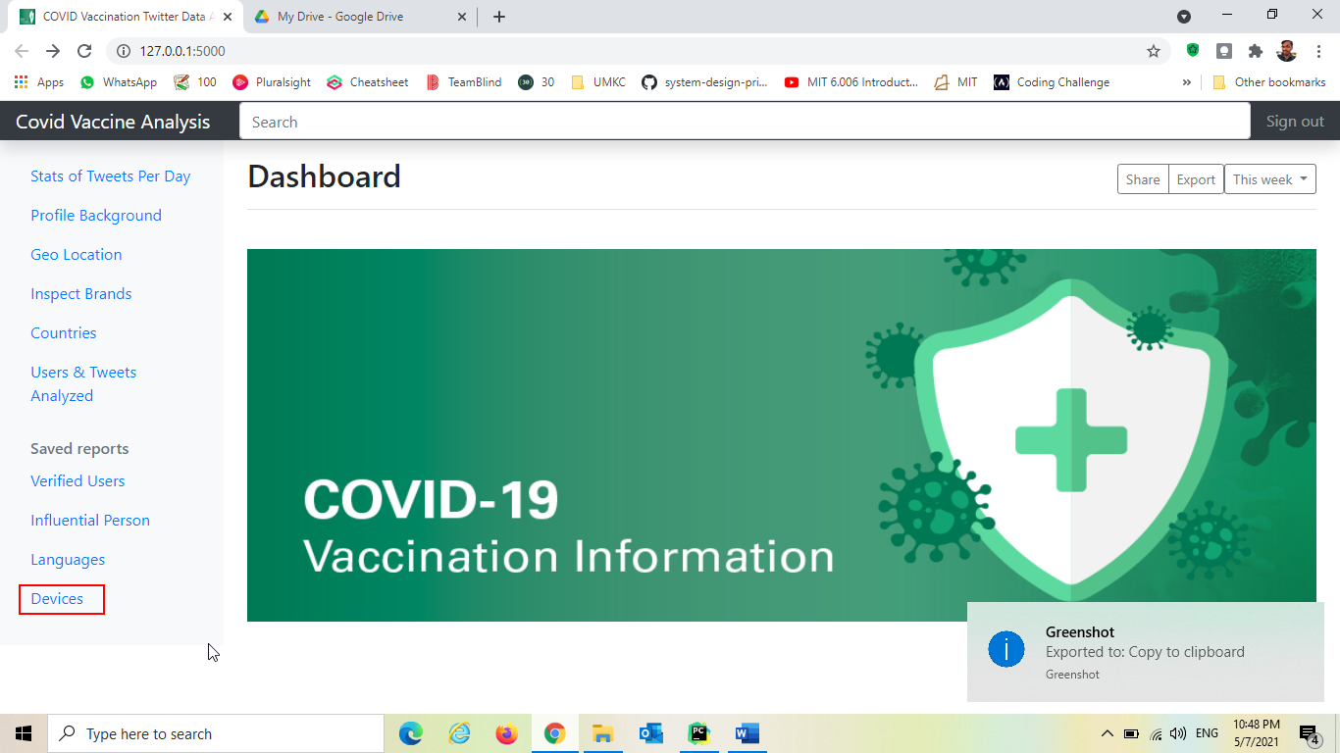
When user clicks on Devices, it goes and triggers the query “Devices Used for Tweets” and dynamically generates visualization and returned to the application.

Slide 57
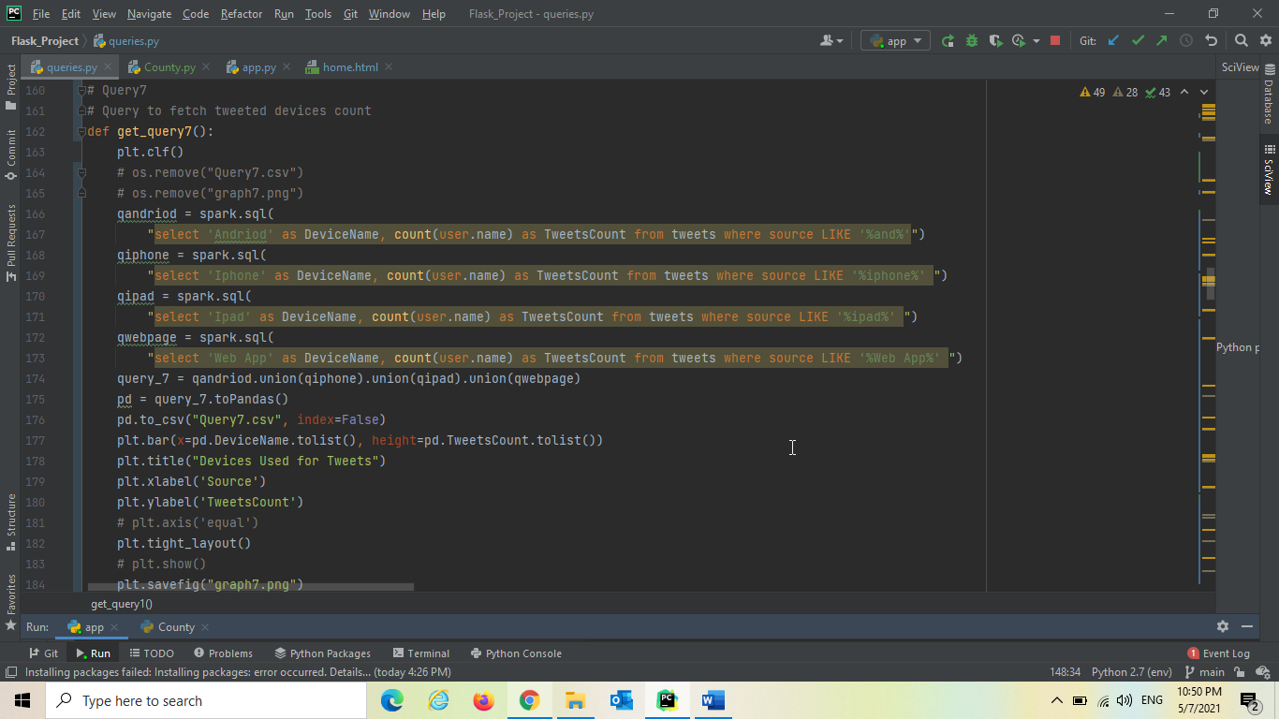
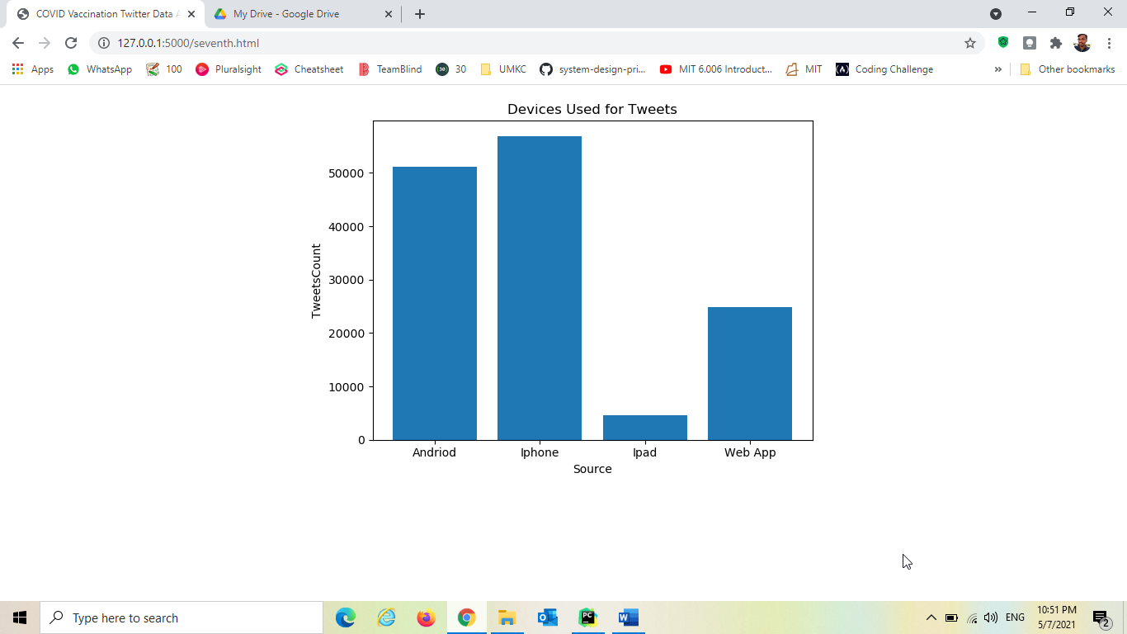

Slide 58
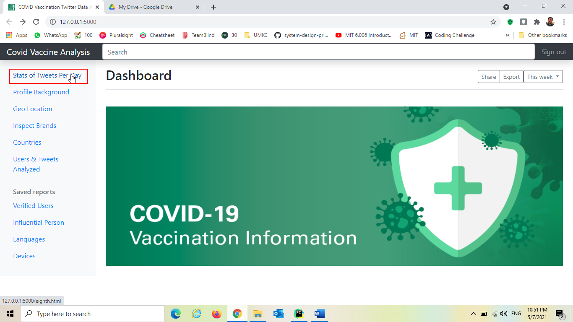
When user clicks on Stats of Tweets Per Day, it goes and triggers the query “Stats of Tweets Per Day” and dynamically generates visualization and returned to the application.

Slide 59
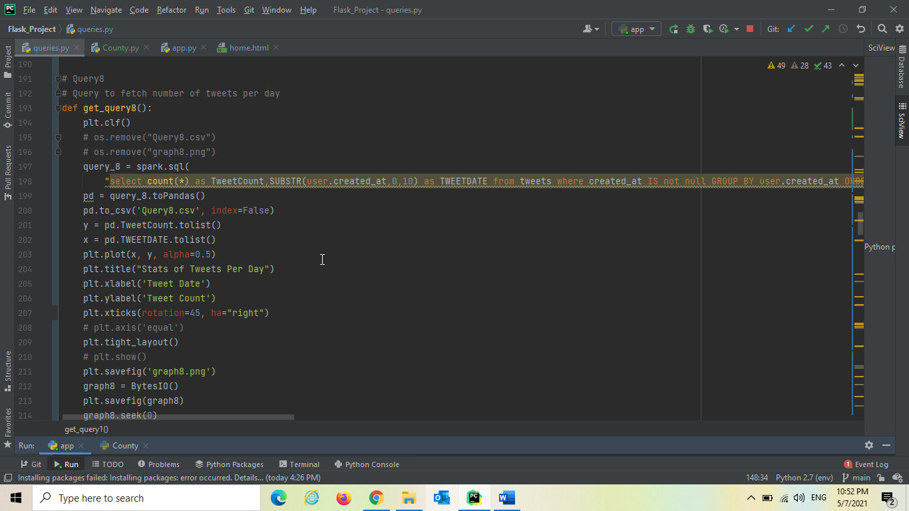
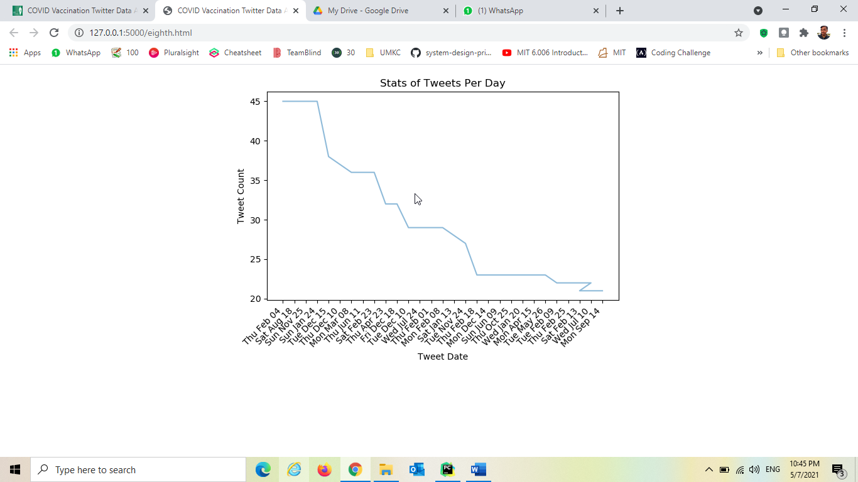

Slide 60

When user clicks User's Profile Background, it goes and triggers the query “User's Profile Background” and dynamically generates visualization and returned to the application.

Slide 61
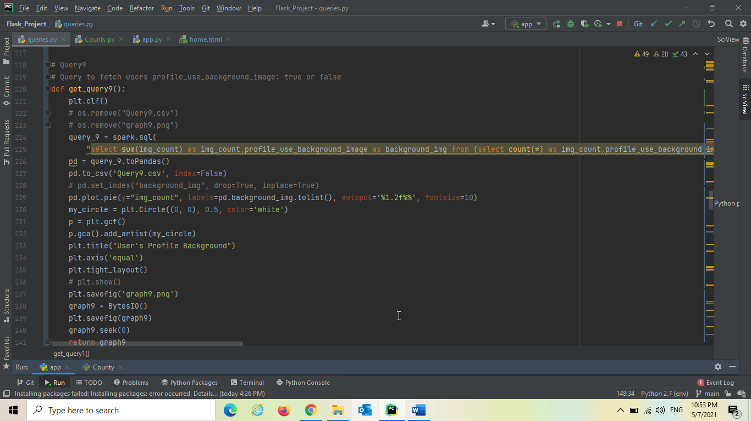
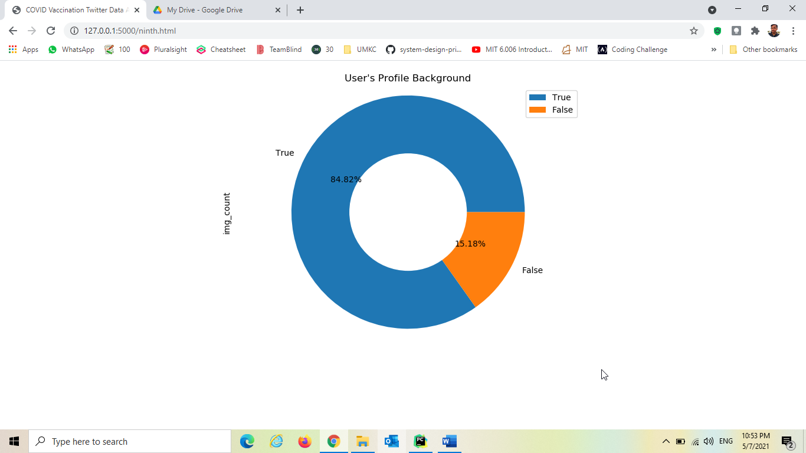

Slide 62

When user clicks Geo Location, it goes and triggers the query “Geo Location Settings Enabled for

Slide 63
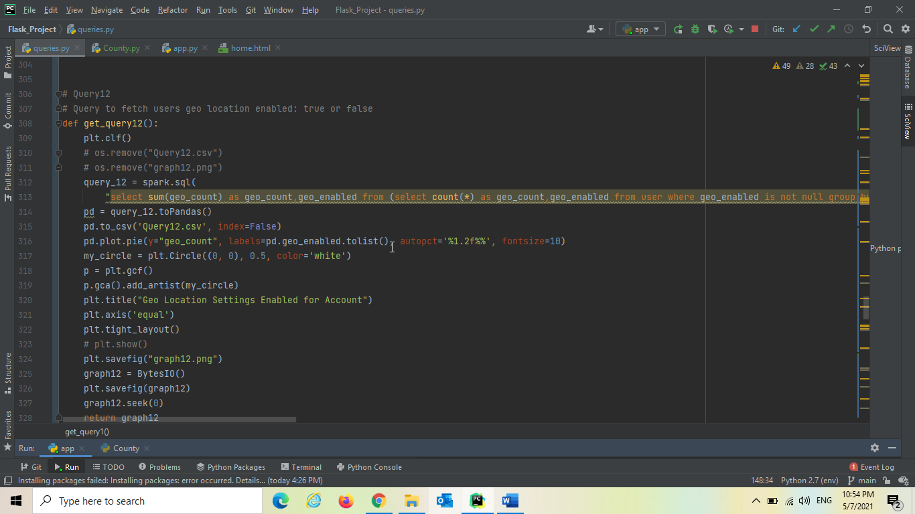
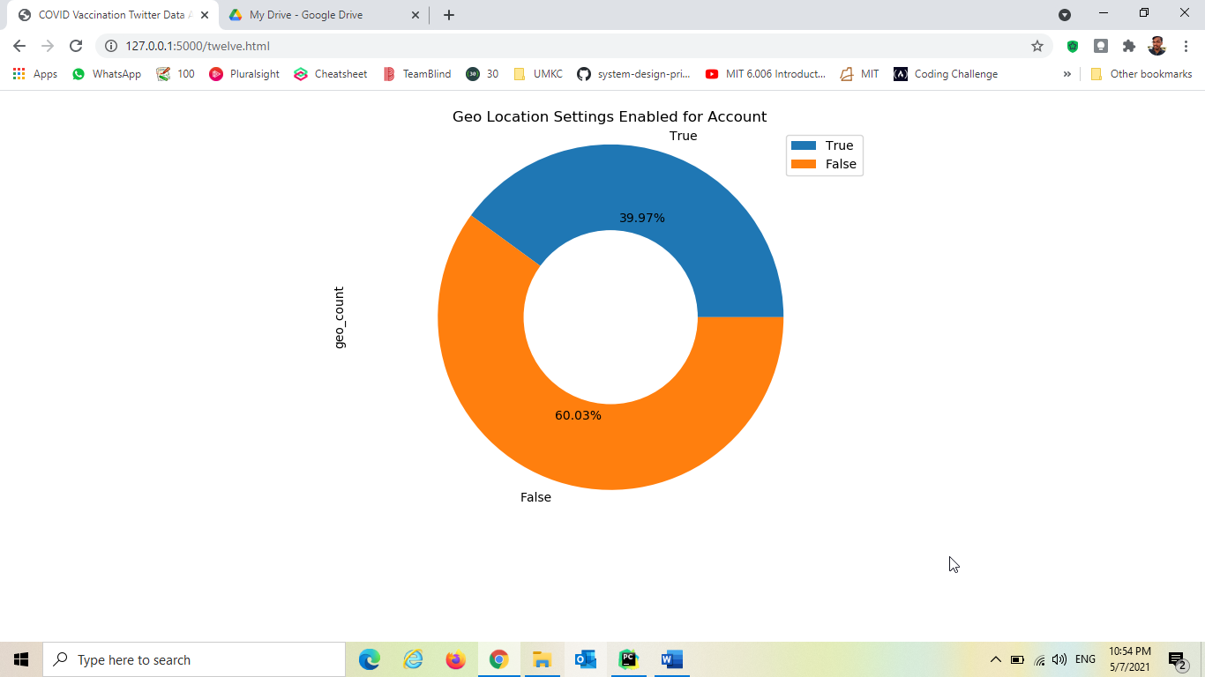

Slide 64

When user clicks Inspect brands, it goes and triggers the query “Inspect Based on brand” and dynamically generates visualization and returned to the application.

Slide 65
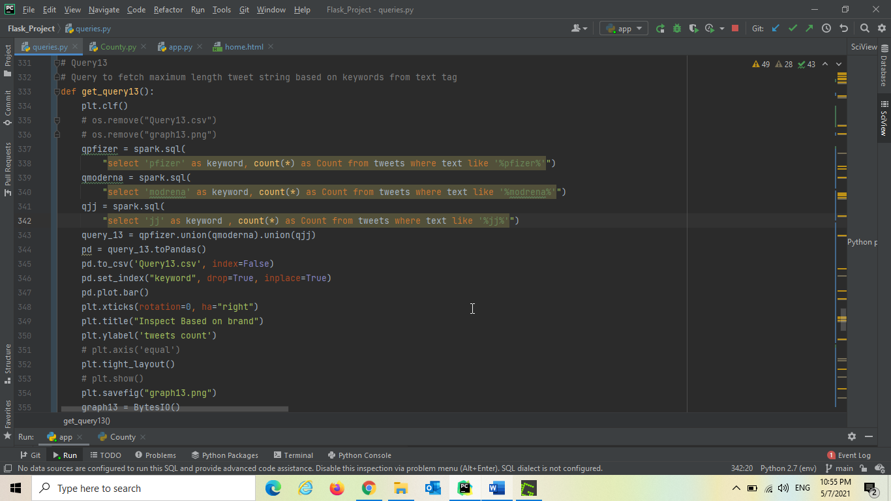
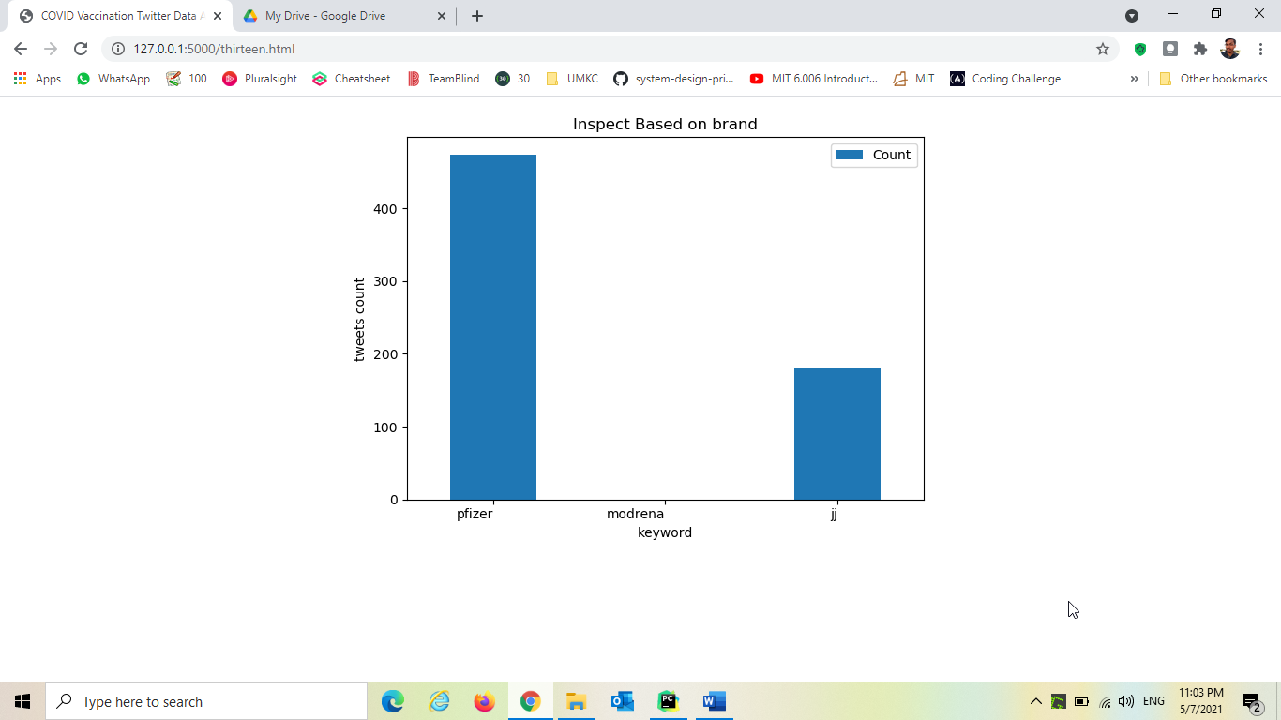

Slide 66

When user clicks Countries, it goes and triggers the query “Twitter Most Used Countries” and dynamically generates visualization and returned to the application.

Slide 67
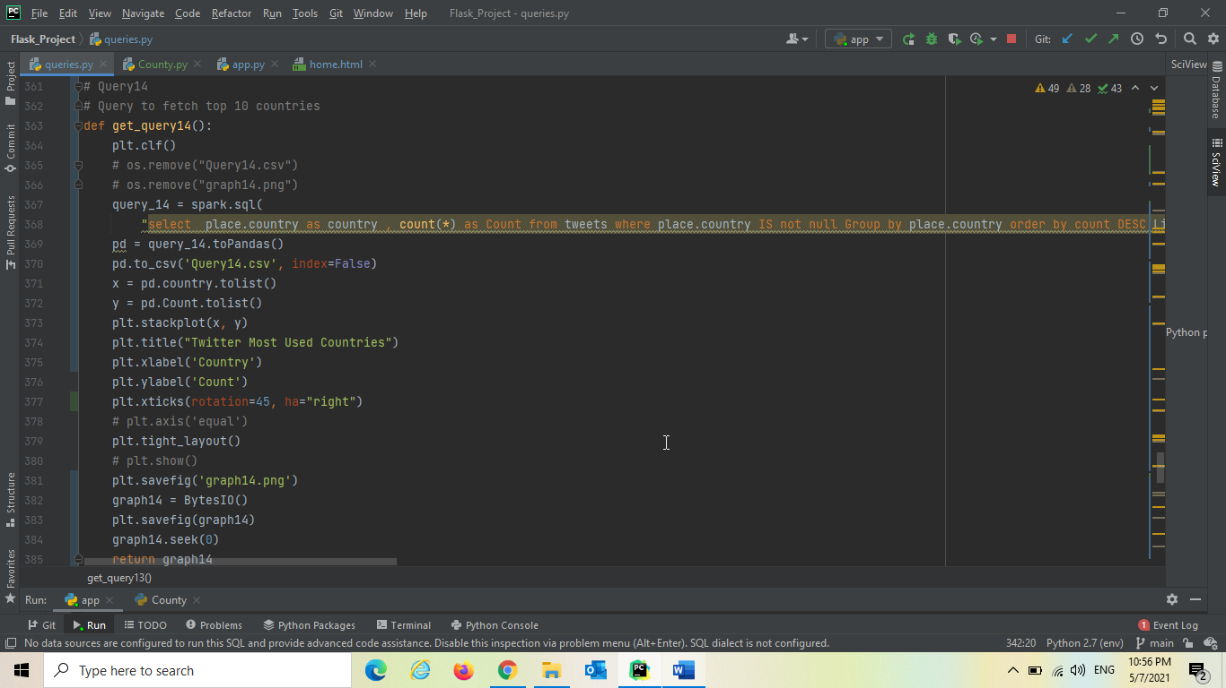


Slide 68


Starting Hive
Loading Data into Hive

Slide 69

Hive Query Language

Slide 70

Describing data :

Slide 71

Data count in table:

Slide 72
Fetch the first-row data in the table

Slide 73

Count for number of persons retweeted.

Slide 74

List of Id’s Retweeted:

Slide 75

Finding out Keyword COVID:

Slide 76

In the year 2019:

Slide 77

December Month Analysis:

Slide 78

Jan Month Analysis:

Slide 79

Alameda county analysis in march month

Slide 80

Counties that are fully vaccinated:

Slide 81


Slide 82

Operation in Solr: Creation of instance:

Slide 83

Creation of collection:

Slide 84

Schema:

Slide 85


Slide 86

Solr UI

Slide 87
References:
https://www.kaggle.com/c/stanford-covid-vaccine
https://www.cdc.gov/coronavirus/2019-ncov/vaccines/index.html
https://hadoop.apache.org/
https://hive.apache.org/
https://spark.apache.org/
https://cassandra.apache.org/
https://lucene.apache.org/solr/
https://developer.twitter.com/en
https://www.djangoproject.com/
https://www.docker.com/
https://www.cloudera.com/products/open-source/apache-hadoop.html
https://covidtracking.com/analysis-updates/how-we-hope-vaccines-will-be-tracked
https://data.chhs.ca.gov/dataset/vaccine-progress-dashboard

Slide 88
Questions?...

Slide 89
Thank You…

